Slide 1


YOLO
PRESENTED BY
KHUSHI DK MEGHA PRASAD
RAJATHA
1MS22AI023
1MS22AI027
1MS22AI047

Slide 2
INTRODUCTION TO YOLO
YOLO (You Only Look Once) is a real-time object detection system that detects and classifies multiple objects in a single image with high speed and accuracy. Unlike traditional methods that apply detection models to various parts of the image multiple times, YOLO treats detection as a single regression problem, predicting bounding boxes and class probabilities directly from full images in one evaluation.
Key Features:
Real-time performance: YOLO is extremely fast, making it ideal for applications like video surveillance, autonomous driving, and robotics.
End-to-end model: It uses a single convolutional neural network (CNN) to predict multiple bounding boxes and class probabilities simultaneously.
Global reasoning: Because YOLO sees the entire image during training and inference, it captures contextual information better than region-based approaches..

Slide 3
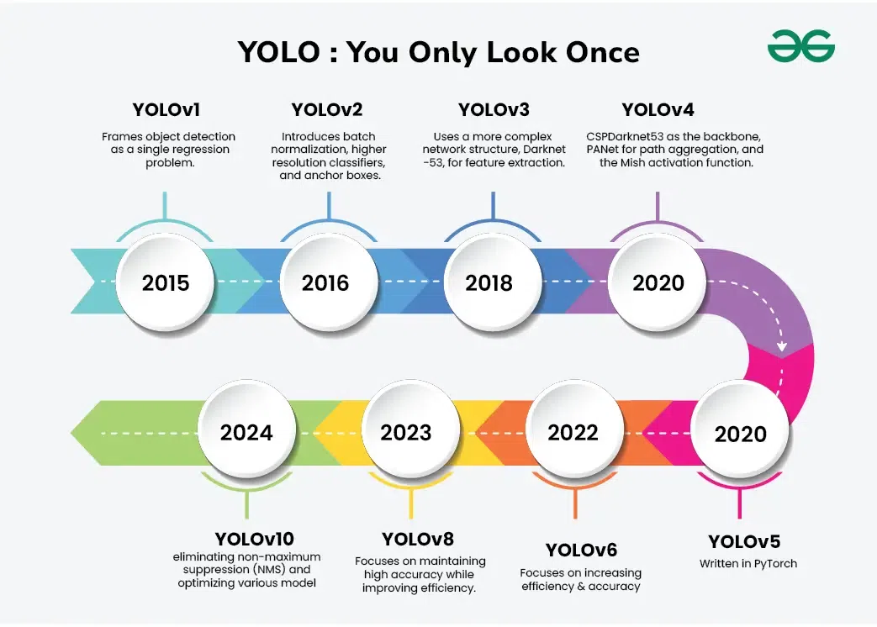
EVOLUTION OF YOLO MODELS
Since its introduction, YOLO has seen several iterations, with improvements in accuracy and speed. From YOLOv1 to YOLOv12, each version enhances performance, scalability, and usability in diverse environments.

Slide 4
YOLO VERSIONS
YOLOv1 (2015):
YOLOv5:
Introduced the idea of single-shot detection.
Fast but less accurate with small objects.
Not developed by the original authors.
Developed by Ultralytics in PyTorch.
Popular for its ease of use and performance.
YOLOv2 (YOLO9000):
YOLOv6, v7, and v8:
Improved accuracy and speed.
Introduced anchor boxes and batch normalization.
Continued improvements in performance, model size, and accuracy.
YOLOv8 (by Ultralytics, 2023) supports instance
segmentation, classification, and detection tasks
YOLOv3:
Used a deeper network (Darknet-53).
Better at detecting small objects and multiple scales.
YOLOv9 and v10:
YOLOv9 prioritizes accuracy by using techniques like PGI and GELAN, making it suitable for scenarios requiring high precision.
YOLOv10, on the other hand, focuses on real-time performance and low latency, achieved through its NMS-free architecture and efficiency optimizations.
YOLOv4 (2020):
Community-developed.
Combined many improvements like CSPDarknet and PANet

Slide 5
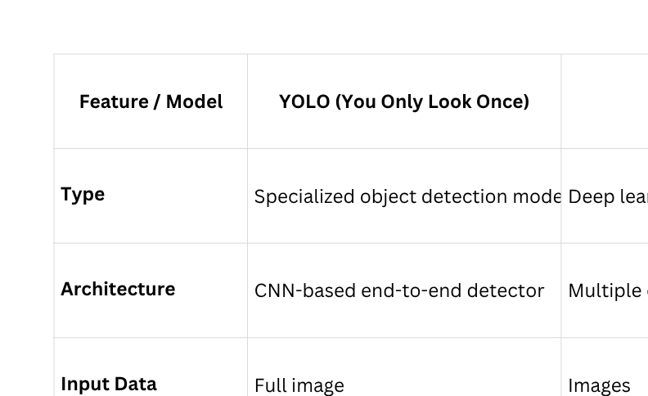
YOLO VS OTHER NEURAL NETWORKS

Slide 6
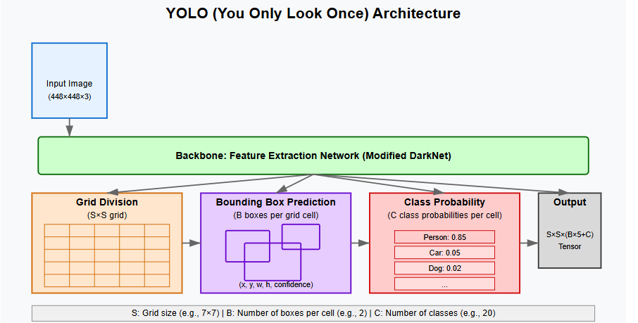
YOLO ARCHITECTURE
Input
Starts with an input image (typically 448×448×3 pixels)
The entire image is processed in a single forward pass
Backbone: Feature Extraction
Uses a modified DarkNet architecture (similar to VGG)
Consists of multiple convolutional layers with leaky ReLU activations
Includes pooling layers for downsampling
Extracts rich feature representations from the entire image

Slide 7
Grid Division
Divides the image into an S×S grid (typically 7×7 in YOLOv1)
Each grid cell is responsible for detecting objects centered within it
Bounding Box Prediction
Each grid cell predicts B bounding boxes (usually 2)
For each box, it predicts:
(x, y): Center coordinates relative to the grid cell
(w, h): Width and height relative to the entire image
Confidence score: Probability of object presence × IoU (Intersection over Union)
Class Probability
Each grid cell predicts C class probabilities
These are conditional probabilities (probability of class given an object exists)
Independent of the number of bounding boxes
Output Tensor
Final output is an S×S×(B×5+C) tensor
For YOLOv1 with S=7, B=2, C=20: 7×7×30 tensor
Post-processing includes thresholding and non-maximum suppression

Slide 8
APPLICATIONS OF YOLO IN E-COMMERCE
Visual Search Engines
Inventory Management
YOLO helps identify products in images uploaded by users.
Enables search by image instead of text.
Uses cameras to monitor warehouse shelves.
Detects low-stock or misplaced products in real-time.
Product Recognition
Virtual Try-On Systems
Detects clothing items, accessories, electronics, etc.
Automatically assigns tags like "red shirt", "blue jeans", "headphones", etc.
Detects body landmarks or product outlines (like glasses or hats).
Allows users to try products virtually using AR.
Personalized Recommendations
Customer Behavior Analysis
Identifies customer behavior and clicked products using object detection.
Suggests related products visually similar to those detected
In physical stores, YOLO detects which products customers interact with.
Improves shelf arrangement and store layout decisions.

Slide 9
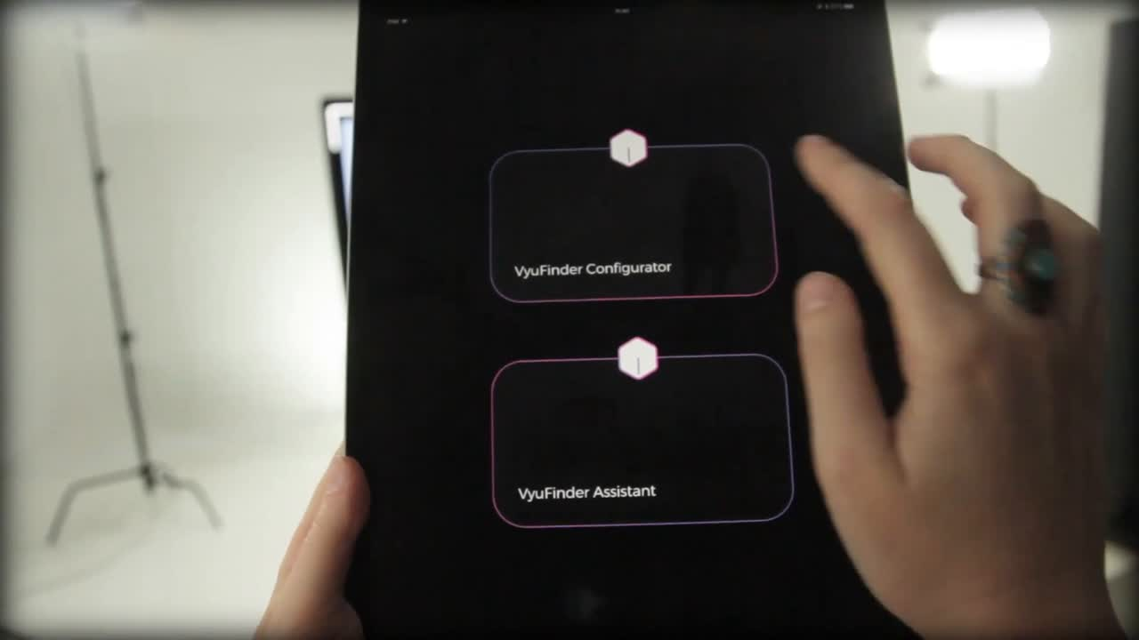

Slide 10
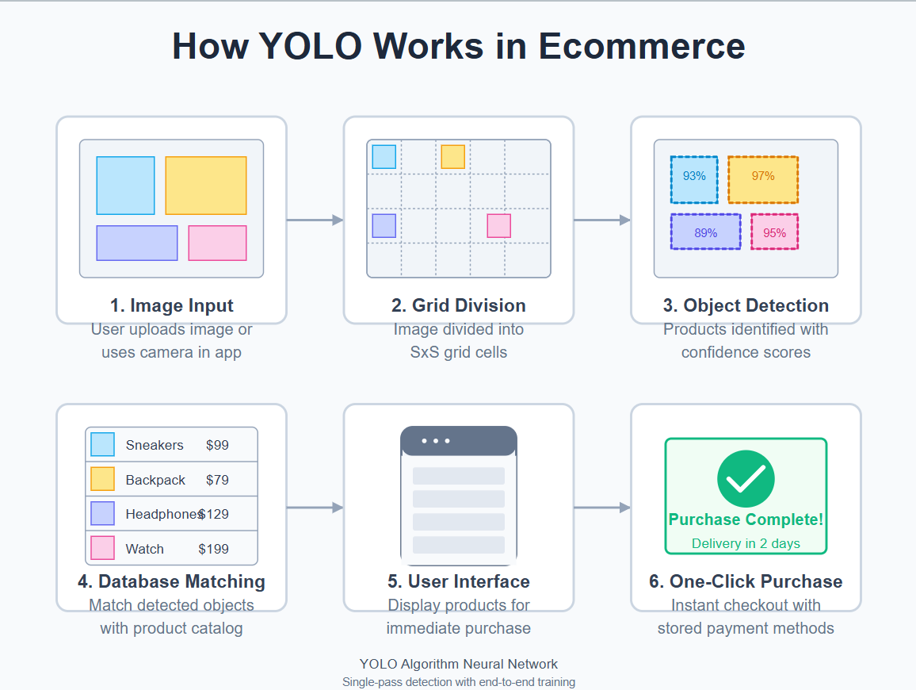
HOW YOLO WORKS IN E-COMMERCE

Slide 11
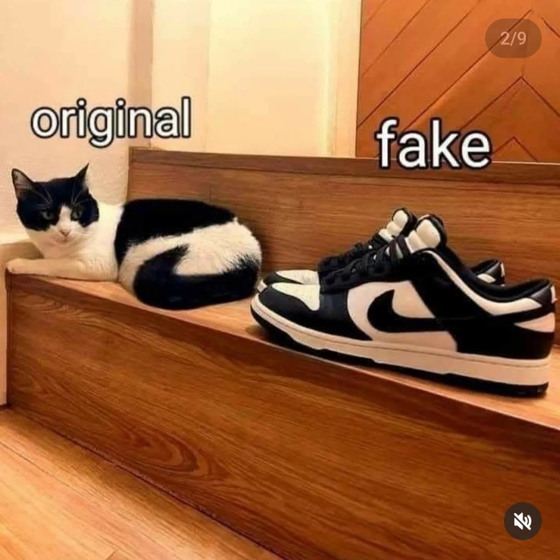

Slide 13
RECENT PAPERS & ADVANCES IN YOLO FOR E-COMMERCE
YOLOv5 to YOLOv8 offer superior performance in video-based retail analytics
YOLO enables real-time product detection and classification with minimal latency
2024 | Mr. Jaisurya Rajasekhar
YOLO’s grid-based detection model supports real-time applications by rapidly predicting bounding boxes and class labels in one pass. This makes it ideal for customer-facing solutions like visual search in e-commerce apps
2024 | Mohajeran et al.
Recent benchmarking of YOLO variants (YOLOX, YOLOv5, YOLOv7, and YOLOv8) showed they are effective in retail and e-commerce scenarios involving object detection in video feeds. YOLOv8 in particular demonstrated top-tier speed and accuracy, which is beneficial for real-time e-commerce applications like automated checkout or product tracking
YOLOv3 for traffic surveillance
YOLOv3 and Tiny-YOLO are effective for lightweight edge deployments
2023 | D.Balakishnan et al.
Implements YOLOv3 to detect traffic-related objects, incorporating data augmentation and transfer learning to enhance detection precision in real-time applications like robotics and surveillance
2021 | Ankith
Simpler YOLO models like YOLOv3-tiny are still relevant for e-commerce settings requiring object detection on mobile or low-resource devices—such as in-store kiosks or handheld scanners

Slide 14
AVAILABLE DATASETS FOR YOLO IN E-COMMERCE
Retail Product Checkout (RPC) Dataset
SKU-110K Dataset
Frexible Dataset for Object Detection (Frex-O)
Description: Dense supermarket shelf images with heavily occluded products.
Use Case: Shelf monitoring, out-of-stock detection.
Classes: 110,000+ annotated supermarket SKUs.
Source: GitHub
Description: Contains images of retail products at checkout counters, useful for cashier-less systems.
Use Case: Automated billing, fraud detection.
Classes: ~200 retail products (grocery, cosmetics, etc.).
Source: Open Images Dataset (Google)
Description: Focuses on deformable products (clothing, bags) in warehouse settings.
Use Case: Defect detection, inventory sorting.
Classes: 50+ deformable item categories.
Source: Frex-O Official
Amazon Bin Image Dataset
DeepFashion2 Dataset
Grocery Store Dataset
Description: Images of products inside warehouse bins for robotic picking systems.
Use Case: Automated order fulfillment.
Classes: 500,000+ bin images with mixed items.
Source: AWS Registry of Open Data
Description: 491K images of fashion items with detailed annotations (bbox, segmentation).
Use Case: Visual search, recommendation engines.
Classes: 13 categories (apparel, accessories).
Source: DeepFashion2 GitHub
Description: 5,000+ images of grocery items on shelves with varying lighting/angles.
Use Case: Price tag recognition, stock management.
Classes: 42 grocery categories (e.g., cereals, beverages).
Source: Kaggle

Slide 15
FUTURE SCOPE OF YOLO IN E-COMMERCE
Hyper-Personalized Shopping Experiences
Autonomous Stores & Smart Carts
Checkout-Free Retail Expansion:
YOLO + sensor fusion (LiDAR, RFID) could enable seamless "just walk out" shopping beyond Amazon Go.
Smart Shopping Carts:
Real-time product detection in carts for instant price updates and stock alerts.
AI-Powered Virtual Try-On:
YOLOv8/v9 could enable real-time virtual fitting rooms by detecting body pose and overlaying clothes/accessories.
Dynamic In-Store Recommendations:
Cameras with YOLO could track customer interest (e.g., gaze, picked items) to suggest products instantly.
Enhanced Fraud & Compliance
Augmented Reality (AR) Commerce
Deepfake Product Detection:
YOLO could identify counterfeit listings by comparing product images against verified references.
Age-Restriction Enforcement:
Instant age verification for alcohol/tobacco sales via ID or facial recognition.
Live AR Product Previews:
YOLO could anchor 3D product models in real-world spaces via smartphones (e.g., "see this sofa in your room").
Interactive Packaging:
Scanning product packaging with YOLO could trigger AR tutorials or promotions.

Slide 16
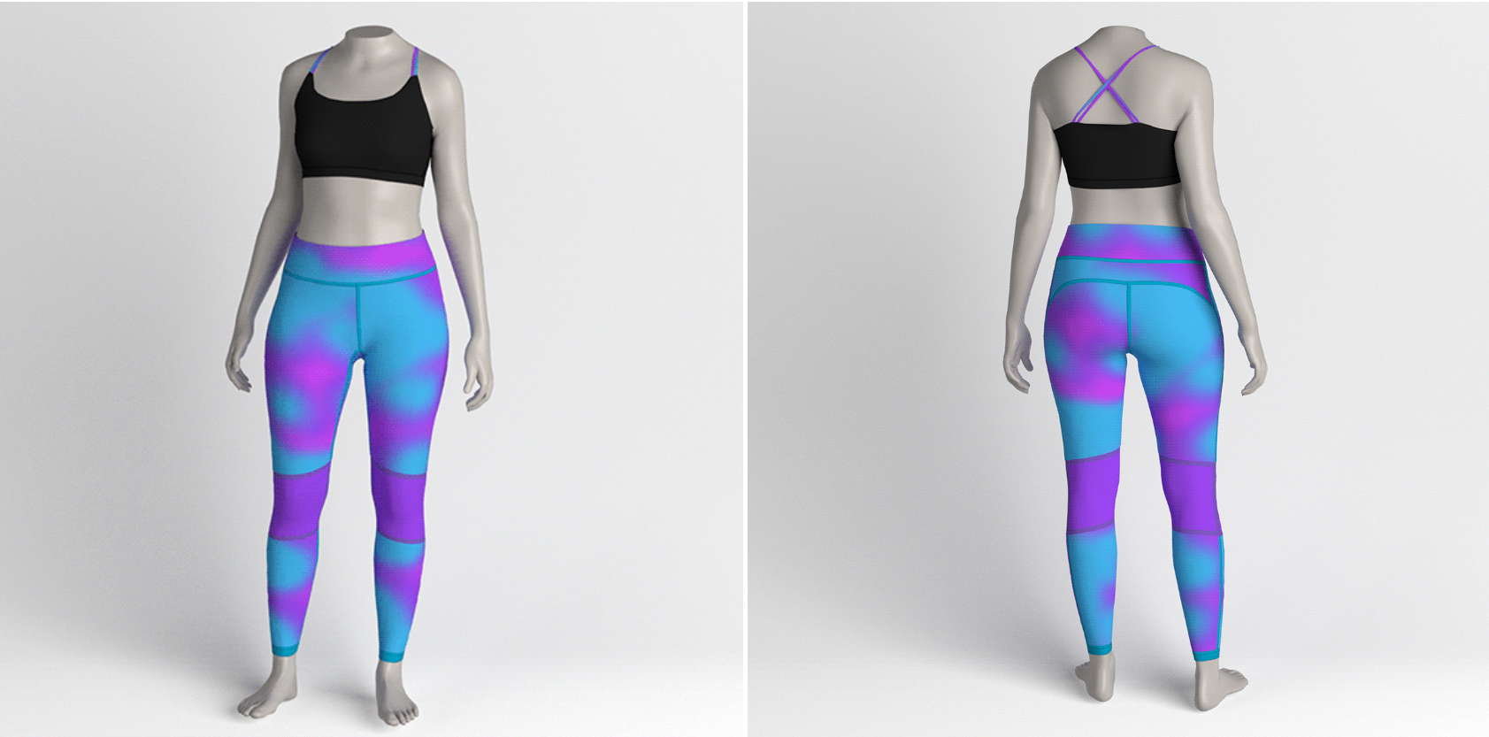
Immersive Shopping Experiences
yolos will power AR/VR shopping experiences, predicting user movements and interactions in virtual stores to create personalized navigation flows.

Slide 17
CONCLUSION
YOLO’s evolution is set to revolutionize e-commerce by bridging the gap between real-time AI vision and seamless customer experiences. As models like YOLOv10 and YOLOv11 push the boundaries of speed and accuracy, we can expect
Frictionless Shopping Ecosystems – From autonomous stores to AI-powered visual search, YOLO will eliminate inefficiencies in inventory, checkout, and logistics.
Hyper-Personalization at Scale – Dynamic product recommendations, virtual try-ons, and smart carts will make shopping more intuitive and engaging.
Sustainable & Fraud-Proof Commerce – By automating quality checks, counterfeit detection, and waste reduction, YOLO will drive ethical and efficient retail practices.
The key to unlocking this potential lies in edge-AI optimization, privacy-aware deployments, and multimodal AI integration (combining vision with NLP and LLMs). While challenges like occlusion handling and real-time processing persist, advancements in lightweight models and synthetic data will pave the way for scalable solutions.
In the next 5 years, YOLO won’t just enhance e-commerce—it will redefine it, making AI-driven retail faster, smarter, and more customer-centric than ever before.

Slide 18
A
Q
Q
A
AND

Slide 19
What does YOLO stand for in computer vision?
A) You Only Learn Once
B) You Only Look Once
C) Your Object Locator Output
D) You Observe Large Objects

Slide 20
B) You Only Look Once

Slide 21
What is the primary advantage of YOLO compared to traditional object detection methods?
A) It is more accurate than all other methods
B) It runs faster by detecting objects in a single pass
C) It requires no training
D) It uses handcrafted features

Slide 22
B) It runs faster by detecting objects in a single pass

Slide 23
Which of the following best describes how YOLO detects objects?
A) By scanning each pixel individually
B) By using a sliding window approach
C) By dividing the image into a grid and predicting boxes per grid cell
D) By matching features with a predefined object database

Slide 24
C) By dividing the image into a grid and predicting boxes per grid cell

Slide 25
Which version of YOLO introduced anchor boxes and batch normalization?
A) YOLOv1
B) YOLOv2
C) YOLOv3
D) YOLOv5

Slide 26
B) YOLOv2

Slide 27
Which of the following is a key improvement in YOLOv3 over earlier versions?
A) It uses sliding windows
B) It eliminates the need for convolutional layers
C) It detects objects at multiple scales
D) It was the first version to use PyTorch

Slide 28
C) It detects objects at multiple scales

Slide 29
THANK
YOU

